Slide 1
A rumor of empathy: What empathy is and how it makes a difference
Lou Agosta, PhD
Northwestern Feinberg Special Lecture
LAgosta@UChicago.edu
August 17, 2016

Slide 2

David Hume: 4 Definitions of Sympathy (1739)
Emotional contagion
Suggestibility
Double representation: an impression of your impression
A Delicacy of sympathy and taste
Benevolence

Slide 3
The secret underground history of empathy
Hume’s definitions of “sympathy” and taste
Kant’s “communicability of affect” and “enlarged thinking” – change perspectives
Lipps’ projective and aesthetic empathy
Freud’s encounter with Lipps
The debunking of Lipps by the phenomenologists Scheler, Stein, Husserl
Rogers and Kohut (empathy no longer a secret)

Slide 4
How empathy functions…
Empathic Receptivity
[a gracious and generous listening]
Empathic Understanding
[breakthrough to possibility]
Empathic Interpretation
[“top down” folk psychology
the view from “over there”]
Empathic Responsiveness
[narrative: the movie of one’s life]

Slide 5
How Empathy Breaks down / Fails
[1]
Empathic Receptivity
[emotional contagion / panic]
[3]
[2]
Empathic Interpretation
[mis-interpretation:
take things out of context /
un-charitable /
second guessing]
Empathic Understanding
[projection / Labeling /
applying categories –
stereotyping]
[4]
Empathic Responsiveness
[thoughtless remarks / gossip / empty talk
Blame / finger-pointing /
“Monday morning quarter-backing”]

Slide 6
Ontology and phenomenology: The short definition of empathy…
Being in the presence of another human being without the addition [interposition] of categories, labels, diagnoses, judgments, evaluations
The experience of relatedness …

Slide 7
Four (4) examples from literature
Thomas Mann / emotional contagion
Thomas Mann / possibility or compassion
Edmund Rostrand (Cyrano de Bergerac) / egocentrism – projection
Tennessee Williams / Responsiveness

Slide 8
Empathy and introspection
If one goes far enough inward, then one finds the other
It is a myth that we are unrelated – we are all related – and the philosopher Descartes’ thought experiment of an isolated consciousness, disconnected from the world missed the relatedness to the other that makes possible consciousness altogether

Slide 9
Empathy and introspection
My reaction to the other person – annoyance, affection, hostility, boredom, compassion, love, hatred, fear, sadness – tells me as much about myself as it does about the other
Reflection on oneself and one’s own issues is required to understand the relationship

Slide 10
Empathy and compassion / altruism
Empathy tells me what the other person is experiencing
Compassion – altruism – good up bringing – training – tell one what to do about it
No particular form of action or behavior is a required consequence of empathy
Empathic responsiveness is an aspect of empathy and gives the other person their own experience back in a form that they recognize as their own

Slide 11
Empathy as filter of variable granularity
If the other person is suffering and you have a vicarious experience of the suffering, then you are going to suffer – but strange as it sounds, not too much
If you are over whelmed by the suffering, you are doing it wrong – you should suffer, but strange as it sounds, not too much
That’s the training …

Slide 12
Example of the good Samaritan
The Levite and the Priest who pass by experienced Empathic Distress –
The Samaritan recognized the suffering of the survivor of the assault – he had a vicarious experience – a trace affect – a sample of the other’s experience
His empathy told him what the other was experiencing – his neighborliness told him what to do about it

Slide 13
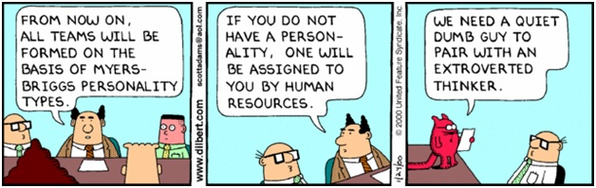
What does it mean to train empathy? Remove obstacles such as categorizing people, labeling, pigeon-holing

Slide 14
What does it mean to train in empathy?
Most people are naturally empathic
Empathy is stopped, limited, reduced, constrained by: shame, guilt, fear, judgments, blame, evaluations, authority, hierarchy, low self-esteem, egocentrism, projection, resignation, narcissism, cynicism, denial …
Remove the obstacles to empathy, and empathy naturally unfolds, shows up, develops
This does not include tips and techniques that can induce, promote, stimulate empathy

Slide 15
Summary and Take Aways
We engaged with
  The history of empathy in Hume, Kant, Lipps, Freud, the phenomenologists
  Examples of empathy and empathic break downs (failures) in literature
  The distinction between empathy and compassion
  Empathy and introspection – empathy as a filter against compassion fatigue

Slide 16
Additional Talking Points
The following slides cover further details on
  The history of empathy in Hume, Kant, Lipps, Freud, the phenomenologists
  Examples of empathy and empathic break downs (failures) in literature
  Peer reviewed journal articles on the impact of empathy on life style diseases (e.g., diabetes 2) and the common cold
  Exercise(s) and miscellaneous talking points

Slide 17
David Hume (1711 – 1776)
‘Tis indeed evident, that when we sympathize with the passions and sentiments of others, these movements appear at first in our mind as mere ideas, and are conceiv’d to belong to another person, as we conceive any other matter of fact. ‘Tis also evident, that the ideas of the affections of others are converted into the very impressions they represent, and that the passions arise in conformity to the images we form of them (1739: 319-20).

Slide 18
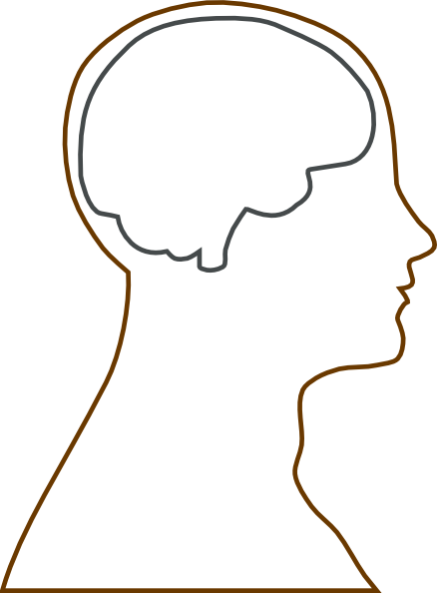
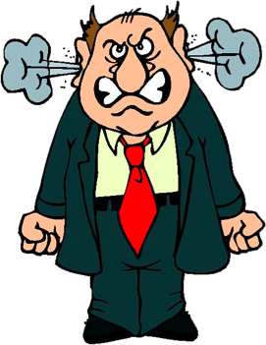
Hume’s ideas and impression
Idea of anger
impression(s)
(1)
one’s impression
of the anger
(2)
convert: impression to idea [understanding]
convert: idea to impression [sympathy / (imagination)]
[drawing not to scale]

Slide 19
Hume’s ideas and impression
Idea of anger
impression(s)
one’s impression
of the anger
+ an idea conceived to belong
to the other persons
convert: impression to idea [understanding]
convert: idea to impression [sympathy / (imagination)]
[drawing not to scale]

Slide 20
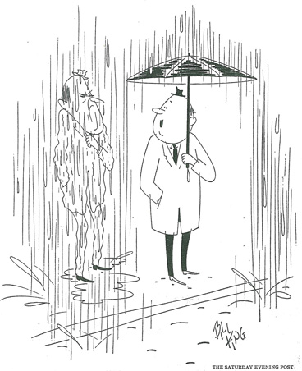
The imagination: Transposing perspectives and generating sympathy
The guy with umbrella says: “We needed
Rain.”
The imagination is responsible for
Converting ideas to impressions in Sympathy
Changing perspectives “as if” I were “over there”
A dis-interested spectator is not cold hearted – lacks a conflict of interest - may still be sympathetic
False belief test

Slide 21
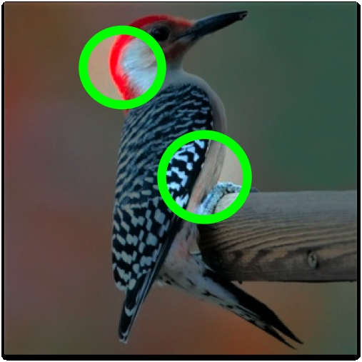
Delicacy of taste vs delicacy of passion
Hume’s example of the cask of sherry …
If you are aware of something of which I lack aware, then your “delicacy” is more fine-grained

Slide 22
David Hume
Every movement of the theatre, by a skillful poet, is communicated, as it were by magic, to the spectators; who weep, tremble, resent, rejoice, and are inflamed with all the variety of passions, which actuate the several personages of the drama (1751: 49).

Slide 23
David Hume
A cheerful countenance infuses a sensible complacency and serenity into my mind; as an angry or sorrowful one throws a sudden damp upon me. Hatred, resentment, esteem, love, courage, mirth and melancholy; all these passions I feel more from communication than from my own natural temper and disposition (T 2.1.11.2; 1739: 316-17).

Slide 24
David Hume
So close and intimate is the correspondence of human souls that no sooner any person approaches me, than he diffuses on me all his opinions, and draws along my judgment in a greater or less degree. And tho’, on many occasions, my sympathy with him goes not so far as entirely to change my sentiments and way of thinking; yet it seldom is so weak as not to disturb the easy course of my thought. . . (T 3.3.2.2; 1739: 592).

Slide 25
David Hume
‘Tis remarkable, that nothing touches a man of humanity more than any instance of extraordinary delicacy in love or friendship. . . The passions are so contagious, that they pass with the greatest facility from one person to another, and produce correspondent movements in all human breast. Where friendship appears in very signal instances, my hart catches the same passion, and is warmed by those warm sentiments, that display themselves me (T 3.3.3.5; 1739: 604-5).

Slide 26
Summary (Hume)
Emotional contagion / suggestion
Conversion of idea to impression
Conversion of idea to impression + The Other
Delicacy of taste impression
Benevolence / compassion

Slide 27
Immanuel Kant
Like taste, empathy is disinterested
Like taste, empathy requires the universal communicability of feelings
Like taste, empathy leverages the form of purposiveness
Like taste, empathy relates necessarily to the other

Slide 28
A rumor of empathy in Kant
The “communicability of feelings” (1790/93a: 174; §40 (AA 294)) sounds like step one of the multi-dimensional approach to empathy.
Kant’s “communicability of feeling” is the clue to the reconstruction of the deep history of empathy in Kant.

Slide 29
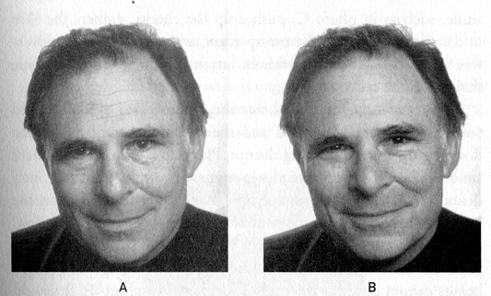

Kant
(1) – (6)
Free play of the imagination and understanding
Subordination of sensibility to infinite reason
Distancing: dis-interestedness
Engagement: communicability of feeling
Engagement with the other (sensus communis)
Purposefulness of the manifold

Slide 30
Immanuel Kant (1790/93)
We call buildings or trees majestic and magnificent, or fields smiling and joyful; even colors are called innocent, modest or tender, because they arouse sensation that contain something analogical to the consciousness of a mental state produced by moral judgments. Taste as it were makes possible the transition from sensible charm to the habitual moral interest without too violent a leap […] (1790/93a: 228; §59 (AA354)).

Slide 31

In a raging storm where is the rage?
rage
one’s impression
of the rage
Kant – “subreption” = “projection”
=
an error I judgment

Slide 32
Immanuel Kant (1790/1793)
. . . [T]he imagination in its freedom arouses the understanding, and the latter, without concepts, sets the imagination into a regular play [and] the representation is communicated, not as a thought, but as the inner feeling of a purposive state of mind.
Taste is thus the faculty for judging a priori the communicability of the feelings [die Mitteilbarkeit der Gefühle] that are combined with a given representation (without the mediation of a concept) (1790/93a: §40; 175-176; (AA: 296)).

Slide 33
Immanuel Kant (1790/93)
This is the moment for top down, cognitive empathic interpretation. Kant explicitly notes this kind of common sense enables us –
  “to put ourselves in thought in the place of every other” (1790/93b: §40; 136; (AA 293) (“…an der Stelle jedes anderen denken…”)).
  This enables one to link back to empathic interpretation and the logical function invoked in substituting a third-person for a first-person perspective.

Slide 34
Theodor Lipps (1851 – 1914)
You know how the movie/play Amadeus showed that Antonio Salieri was famous in his day and is now unknown in comparison with Mozart?
Lipps was the Salieri of “empathy,” dominating the term up until 1914 and beyond whereas today he is unknown

Slide 35
Theodor Lipps (1885/1903)
Lipps substitutes “empathy” for “aesthetic taste”
We project our “feeling of vitality and emotions” into nature and into other people
Lipps is famous in his day – and “owns” the word “empathy” [einfühlung]
Lipps’ “projective empathy” becomes the “target” of the critique by the phenomenologists Scheler, Husserl, Stein, and Heidegger [which brings us to the present]

Slide 36
Theodor Lipps
Only in so far as this empathy exists are forms beautiful. Their beauty is this ideal freedom with which I express life [Sichausleben] in them. Conversely, form is ugly when I am unable to do this, when I feel unfree inwardly, inhibited, subjected to constraint with regard to form, or in regard to its contemplation (1903: 247).

Slide 37
Theodor Lipps
In full, positive empathy only one individual ego exists for me; namely this empathized or objectified own ego, which is projected into an external object (1909: 194).

Slide 38
Theodor Lipps
In inner imitation there is no separation between the acrobat up above and me below. On the contrary, I identify myself with him. I feel myself in him and in his place. . . .

Slide 39
Theodor Lipps
In such inner imitation I discharge—not the motions which the acrobat discharges—rather I discharge immediately, or inwardly, or in thought, the motions of the acrobat. I discharge the motions in so far as this discharge of motion is not an external but an inner act in the acrobat himself (1903: 121-122).

Slide 40
Theodor Lipps
In inner imitation there is no separation between the acrobat up above and me below. On the contrary, I identify myself with him. I feel myself in him and in his place. . . .
In empathy, therefore, I am not the real ego [ich] but am inwardly liberated from the latter, i.e., I am liberated from everything which I am apart from the contemplation of form. I am only this ideal, this contemplating ego (1903: 247).

Slide 41
Theodor Lipps
The “other” is one’s own personality, a modified own ego, which is represented and modified according to the external appearance and the perceptible expressions of life. The man besides me, of which I am conscious, is a duplicate and at the same time a modification of my self. (1903: 106).

Slide 42
Theodor Lipps
The first material and occasion for the construction of the foreign personality is offered by his expression of life, the audible and visible, the sounds and physiognomy or gesture, in short, the expressive movements (1903: 106).

Slide 43
The Tangle
Lipps owns the term “empathy”
No one can use the word without appearing to be a student of empathy – but …
Freud is his own man
The phenomenologists – Max Scheler, Edith Stein, Edmund Husserl, Martin Heidegger – argue against Lipps’ theory of “projective empathy”

Slide 44
Max Scheler (1874 – 1928)
It is perfectly meaningful to say: “I can feel for you vicariously, but I have no pity [“Mitleid”] for you.” Such “vicarious feeling” remains within the cognitive sphere, and is not a morally relevant act. The historian of motives, the novelist, the exponent of the dramatic arts, must all possess in high degree the gift of vicarious feeling. But there is not the slightest need for them to share the feelings of their subjects and personages (1912/22: 9).

Slide 45
Max Scheler
. . . Neither “projective empathy” nor “imitation” is necessary in order to explain the primary components of shared feeling, namely, understanding and vicarious feeling and [vicarious] life [Nachfühlen und Nachleben] 1912/22).
“Imitation” is “Nachahmung” (“ahmen” means “to measure,” usually an amount of liquid), while once again “shared feeling” translates “Mitgefühl.”

Slide 46
Sigmund Freud
Freud’s letter to Wilhelm Fliess (August 31, 1898):
In Lipps I have rediscovered my own principles quite clearly stated – perhaps rather more so than suited me. “The reader often finds more than he seeks.” Lipps regards consciousness as only a sense organ, the contents of the mind as ideation, and all mental processes as unconscious (Freud 1887/1902: 262-263).

Slide 47
Edmund Husserl (1859 - 1938)
Every ego is a “monad.” But the monads have windows. They do not have windows or doors through which other subjects can literally [reel] get in—the windows are instances of empathy—but rather through which others can get through and be experienced in a way similar to one’s own past remembrances (Husserl XIV: 260). . . .

Slide 48
Edmund Husserl
A monad thus has windows in order to receive foreign impressions [fremde Einwirkungen]. The windows are empathy (Husserl XIV: 295) . . . .

Slide 49
Edmund Husserl
In one monad, other individual monads are “directly” mirrored through empathy….Thus the other ego and its psyche announces itself in me, and I announce myself in it: We are related to one another consciously and know about one another: and, thereby, every one of us has experience of the other body [fremdleib] and apperceives this according to its own body analogically as body (XIV: 300).

Slide 50
Sigmund Freud
Freud’s letter to Wilhelm Fliess (August 31, 1898):
In Lipps I have rediscovered my own principles quite clearly stated – perhaps rather more so than suited me. “The reader often finds more than he seeks.” Lipps regards consciousness as only a sense organ, the contents of the mind as ideation, and all mental processes as unconscious (Freud 1887/1902: 262-263).

Slide 51
Freud
“The doctor will certainly forfeit any advantage which he might have in relating to his patient if he begins with any other approach than empathy” [Recommendations for Physicians, 1912]
22 mentions of Einfühlung [empath] in 24 volumes of the Standard Edition – most mis-translated

Slide 52
Trains passing in the night – simultaneous separate discovery (?)
Carl Rogers: On Becoming a Person: unconditional positive regard
Heinz Kohut: vicarious introspection, empathic breakdowns [empathy violations], and narcissistic rage
No evidence that Rogers read Kohut or vice versa
Kohut was probably reading Ferenczi, Baliant; Rogers, Martin Buber [existentialism], Niehbur, R.

Slide 53
4 phases of empathy capture multiple definitions
Receptivity: Kohut: Vicarious introspection
Understanding: Heidegger: Possibility
Interpretation: Folk Psychology: Walk in the other person’s shoes
Responsiveness: Dali Lama – prosocial behavior: Loewald: giving the person their own experience back in words

Slide 54
Detailed examples from literature…
Thomas Man: Buddenbrooks
Edmund Rostrand: Cyrano De Bergerac
Tennessee Williams: The Glass Menagerie

Slide 55
Example of empathic receptivity
a vignette of empathic distress in Mann’s character of the dentist, Herr Dr. Brecht, whose would-be empathy for his patients misfires and degenerates into emotional contagion that is such that he (Dr. Brecht) breaks out in a cold sweat and has to sit down exhausted after each dental procedure. In short, Dr. Brecht has available the vicarious experiences that would make him a good empathizer if he were able to control them; but, being endowed with an especially sensitive, delicacy of empathy, instead Dr. Brecht falls prey to empathic distress. (Thomas Mann. (1901). Buddenbrooks, tr. H. T. Lowe-Porter. New York: Random House, 1961: 403–404.
)

Slide 56
Example of empathic receptivity
The bad thing about him [Dr Brecht] was he was nervous, and dreaded the tortures he was obliged to inflict. ‘We must proceed to extraction …,’ he would say, growing pale. Hanno himself was in a pale cold sweat, with staring eyes, incapable of protesting or running away; in short, in much the same condition as a condemned criminal. He saw Herr Brecht, with the forceps his sleeve, bend over him, and noticed that little beads were standing out on his bald brow and that his mouth was twisted. When it was all over, and Hanno, pale and trembling, spat blood into the blue basin at his side, Herr Brecht too had to sit down, and wipe his forehead and take a drink of water.” (Thomas Mann. (1901). Buddenbrooks, tr. H. T. Lowe-Porter. New York: Random House, 1961: 403–404.
)

Slide 57
Example of empathic understanding
Situation: Thomas is Hanno’s father – he is a frustrated artist who has pursued a career in business to support his family – his son, Hanno, is artistic – is sickly with bad teeth, gets bullied in school and can never seem to satisfy his father’s demands for good grades and a kind of “Hail fellow well met!” attitude
Meanwhile Thomas wife, Gerda, is playing passionate violin duos up stairs with her friend, the Lieutenant – the music stops … long silence …

Slide 58
Example of empathic understanding
But his father did not seem to be listening. He held Hanno’s free hand and played with it absently, unconsciously fingering the slim fingers.
And then Hanno heard something that had nothing to do with the lesson at all: his father’s voice, in a tone he had never heard before, low, distressed, almost imploring; “Hanno—the lieutenant has been more than two hours with Mamma.”
Little Hanno opened wide his gold-brown eyes at the sound; and they looked, as never before, clear large, and loving, straight into his father’s face, with its reddened eyelids under the light brows, its white puffy cheeks and long stiff moustaches. God knows how much he understood. But one thing they both felt: in the long second when their eyes met, all constraint, coldness, and misunderstanding melted away. Hanno might fail his father in all that demanded vitality, energy and strength. But where fear and suffering were in question, there Thomas Buddenbrooks could count on the trust and devotion of his son. On that common ground they met as one” (Buddenbrooks. (1901): 507; modified slightly).

Slide 59
Example of empathic understanding
Their eyes meet – an empathic moment
The possibility of relatedness based on vulnerability
The father who was so inaccessible becomes vulnerable in his suffering – Hanno “gets” his vulnerability – that is, his humanity.
If empathic understanding breaks down, one gets projection or egocentrism – that’s what we get on the part of Thomas who wants to make Hanno “a chip off the old block”

Slide 60
Empathic interpretation
Edmond Rostand’s play Cyrano de Bergerac, Cyrano gives up the hope of winning the love of Roxanne because of his unattractive nose, the ultimate symbol of his social awkwardness. Instead Cyrano woos Roxanne vicariously through the more superficially attractive Christian, by putting himself in the place of Christian – swapping roles – putting his own skills as a poet and nobleman at Christian’s disposal.

Slide 61
Empathic interpretation
Christian is really a puppet whose strings are being pulled by Cyrano, who hopes that Roxanne sees through Christian to the real humanity that lies with him (Cyrano).
Alas, love is blind, even if empathy is not. Cyrano’s empathic responsiveness is rendered ineffective by being displaced from expressions on his own behalf to expressions benefiting Christian, the pretender. Cyrano might have risen to the level of empathy – he is receptive enough to gather the relevant experiences – but his empathy is inhibited by his low self-esteem and social awkwardness.

Slide 62
Empathic responsiveness
Break downs in empathic responsiveness are common: gossip, changing the subject, finger pointing, blaming the victim, cheerfulness in the face of decidedly traumatic events – not to mention misuse of language in deception, half truths, and out-and-out lying …
Example of what not to do [for the guys]:
“You are just like your mother.”

Slide 63
Empathic responsiveness
A good example: In Tennessee William’s The Glass Menagerie, Laura is a fragile isolated young lady – like her collection of delicate glass animals – she went to grade school with Tom and had a crush on him – he comes to dinner innocently enough at the invitation of the mother, Amanda, although he is already engaged to be married … Laura had pleurisy as one of her childhood illnesses and she walks with a slight limp …

Slide 64
Empathic responsiveness
Tom calls her “blue roses” – which was his childhood mis-hearing of the teacher saying she was sick and out of school due to “pleurosis”
Laura defines herself as this defect – a slight limp that is hardly noticeable – but as she walks up the aisle in the school auditorium seems to make a thunderous CLUMP in her own perception

Slide 65
Empathic responsiveness
It is a break down because Tom tries to give Laura back her own experience of low self esteem in his response of “blue roses” – not a broken gait but something beautiful
It does not work for so many reasons – including the playwrights commitment to having a broken heart and emotional devastation …

Slide 66
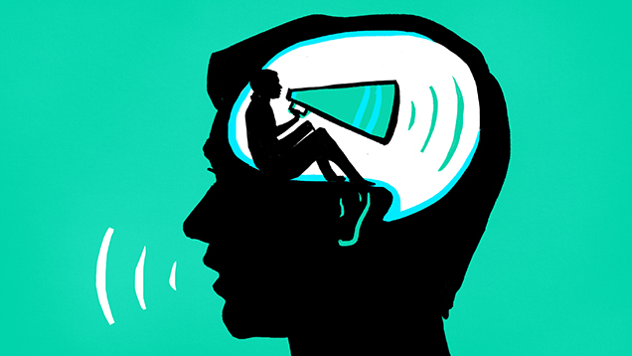
Exercise

Slide 67
I can’t hear you because I am constantly talking to myself about what you are saying
Not how to listen better – how to expand one’s listening …
Walking down the street – commenting on the people – what’s for dinner – what up tomorrow – what’s wrong – what’s right (etc.)
Stop and give it a listen ….

Slide 68
How to listen
When a person distinguishes the noise and statements of the voice over, then what is left is a space to be with the other person and listen to what she or he has to say
That is the empathic moment – to just be with the other – and respond out of nothing

Slide 69
The Doctor as Instrument
The doctor himself [herself] is a powerful therapeutic agent. In ancient times the doctor was almost the only effective treatment and more recently Balint has described the doctor as the most frequently used drug in general practice.
- K.B. Thomas, The Consultation and the Therapeutic Illusion, British Medical Journal 20 May 1978 [M. Balint, The Doctor, His Patient, and the Illness. Tunbridge Wells: Pittman Meddical, 1975.

Slide 70
Doctors change the meaning of the term “empathy”
Outside the field of medicine, empathy is a mode of understanding that specifically involves emotional resonance
Jodi Halpern, MD, PhD, “What is Clinical Empathy? J Gen Intern Med 2003 Aug: 18(8): 670 - 674

Slide 71
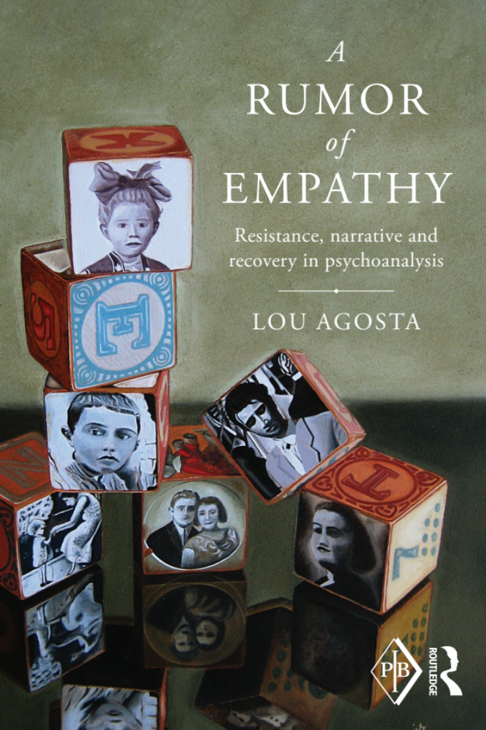
The book that got me thrown out of the Institute For Psychoanalysis
“Empathy is oxygen for the soul.”
“Anyone else here feeling short of breath?”
Terminated!
Maybe one needs expanded empathy!?

Slide 72
Empathy and diabetes ?!
Patients of physicians with high empathy scores with significantly more likeley to have good control of hemoglobin A1c (56%) than were patients with low empathy scores (40%, P < .001).
    M. Hojat et al, (2011), Physicians empathy and clinical outcomes for diabetic patients, ACAD MED MAR; 86(3): 359 – 64: doi: 10.1097ACM.0b013e3182086fe1

Slide 73
Empathy and cholesterol ?!
[…] The results of the LDL-C tests grouped into good control (<100) and poor control (>130) [….] The proportion of patients with good LDL-C control was significantly higher for physicians with high empathy sores (59%) than physicians with low scores (44%, P < .001).
    M. Hojat et al, (2011), Physicians empathy and clinical outcomes for diabetic patients, ACAD MED MAR; 86(3): 359 – 64: doi: 10.1097ACM.0b013e3182086fe1

Slide 74
Meta Analysis
“ […] There is a statistically significant effect for the influence of the therapeutic relationship on healthcare outcomes [d = -.23 to .66; combined effect size was d = .11 (p = .02)
    John M. Kelley, Helen Riess et al, The Influence of the Patient-Clinician Relationship on Healthcare Outcomes: A Systematic Review and Meta-Analysis of Randomized Controlled Trials, PLOS ONE [Public Library of Science], April 2014, Vol. 9, Issue 4;

Slide 75
Empathy and the common cold?!
In those with perfect CARE [Consultation and Relational Empathy] scores, cold durations with shorter (mean 7.10 days versus 8.01 days) [….] In these models, a perfect score also correlates with a larger increase in IL-8 [immune cytokine] levels (p=0.015)
  David P. Rakel et al, (2009),”Practitioner Empathy and the Duration of the common Cold, Fam Med 41(7): 494 – 501.

Slide 76
More Take Aways and Summary
The secret, underground history of empathy traverses Hume’s “delicacy of sympathy” and Kant’s “communicability of feeling”
Empathy is hard to teach, but one way to do so is remove the obstacles to empathy – remove the obstacles and empathy shows up
Listening to one’s listening – the voice over
The multi-dimensional definition of empathy
Disorders of empathy

